Slide 1
Brighton Snow Safety Avalanche Mitigation Routes, Avalanche Mitigation Log Sheets, and Route Safety
By - Peter Tucker

Slide 2
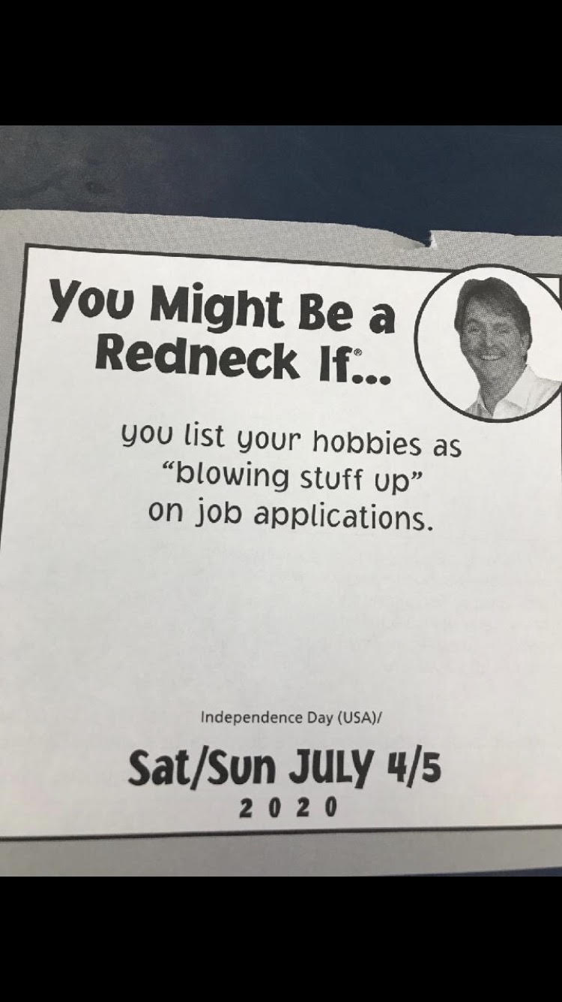
Goals-
Show ‘Traditional’ explosive placement in avalanche mitigation paths.
Overview of Avalanche Mitigation Log Sheets, aka Shot Sheets
Route Safety Techniques

Slide 3
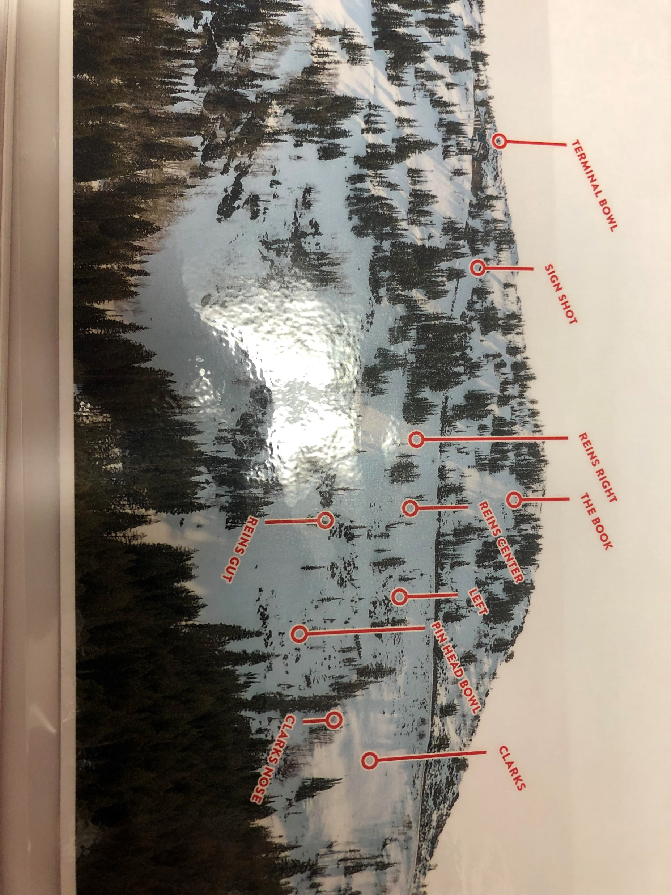
Great Western High Route - Claytons

Slide 4
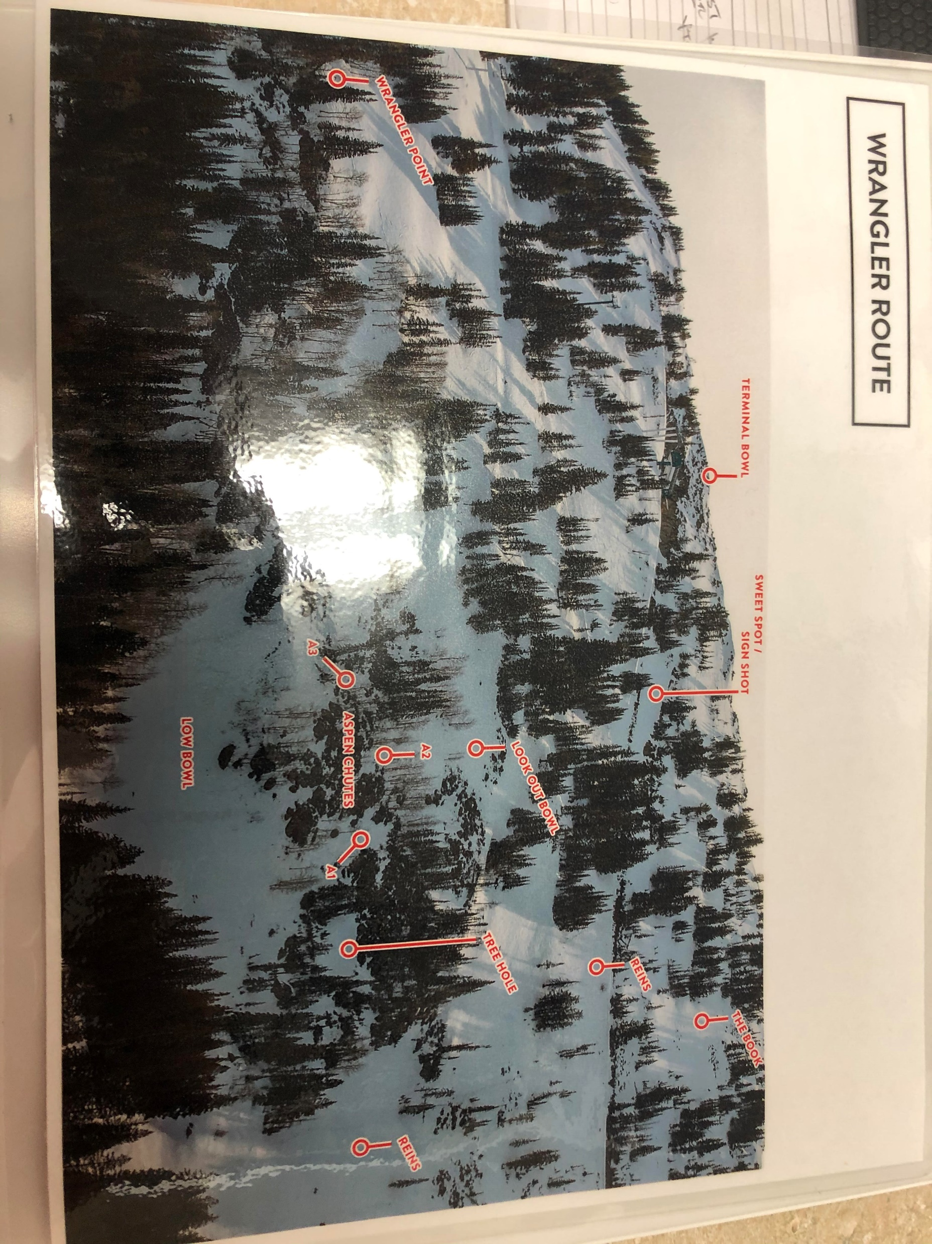
Great Western Low Route - Wrangler

Slide 5
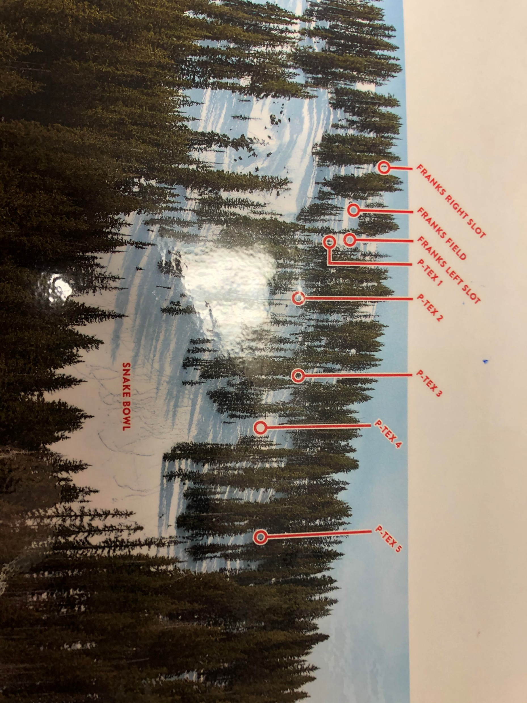
Snake High Route Snake High and Low plan routes together Snake High goes Skiers left and cuts T-road shots

Slide 6
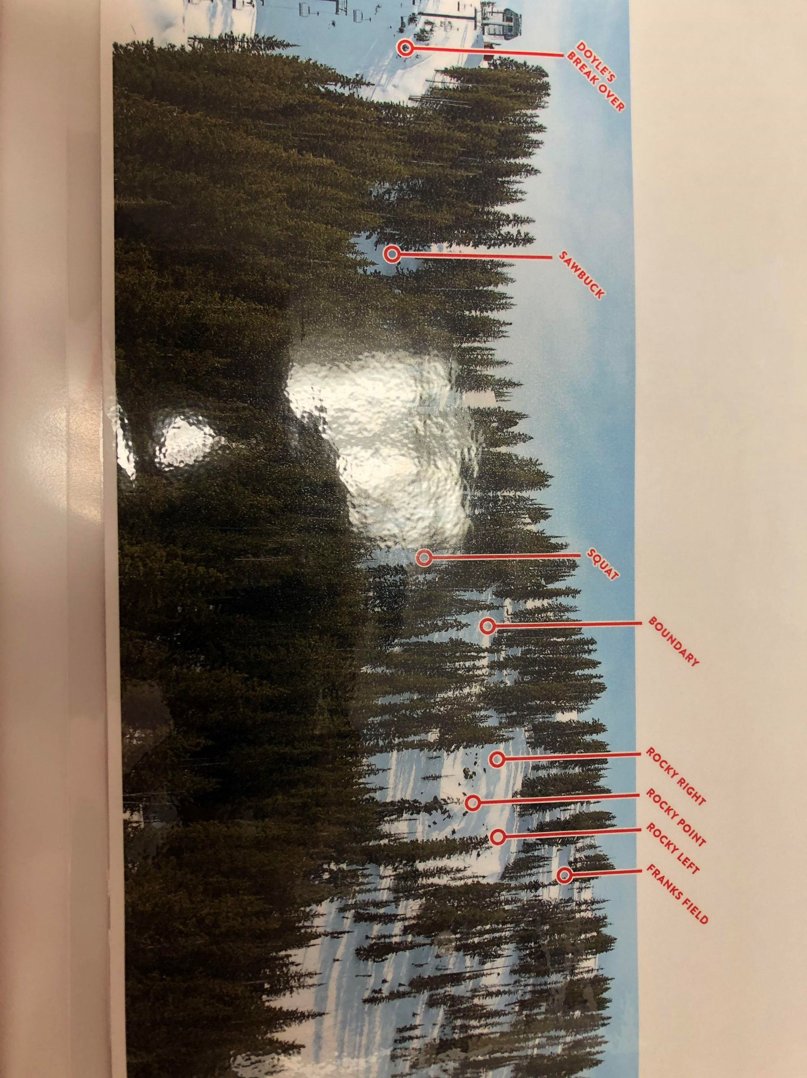
Snake Low Route Snake Low continues to Surf and Turf, not shown

Slide 7
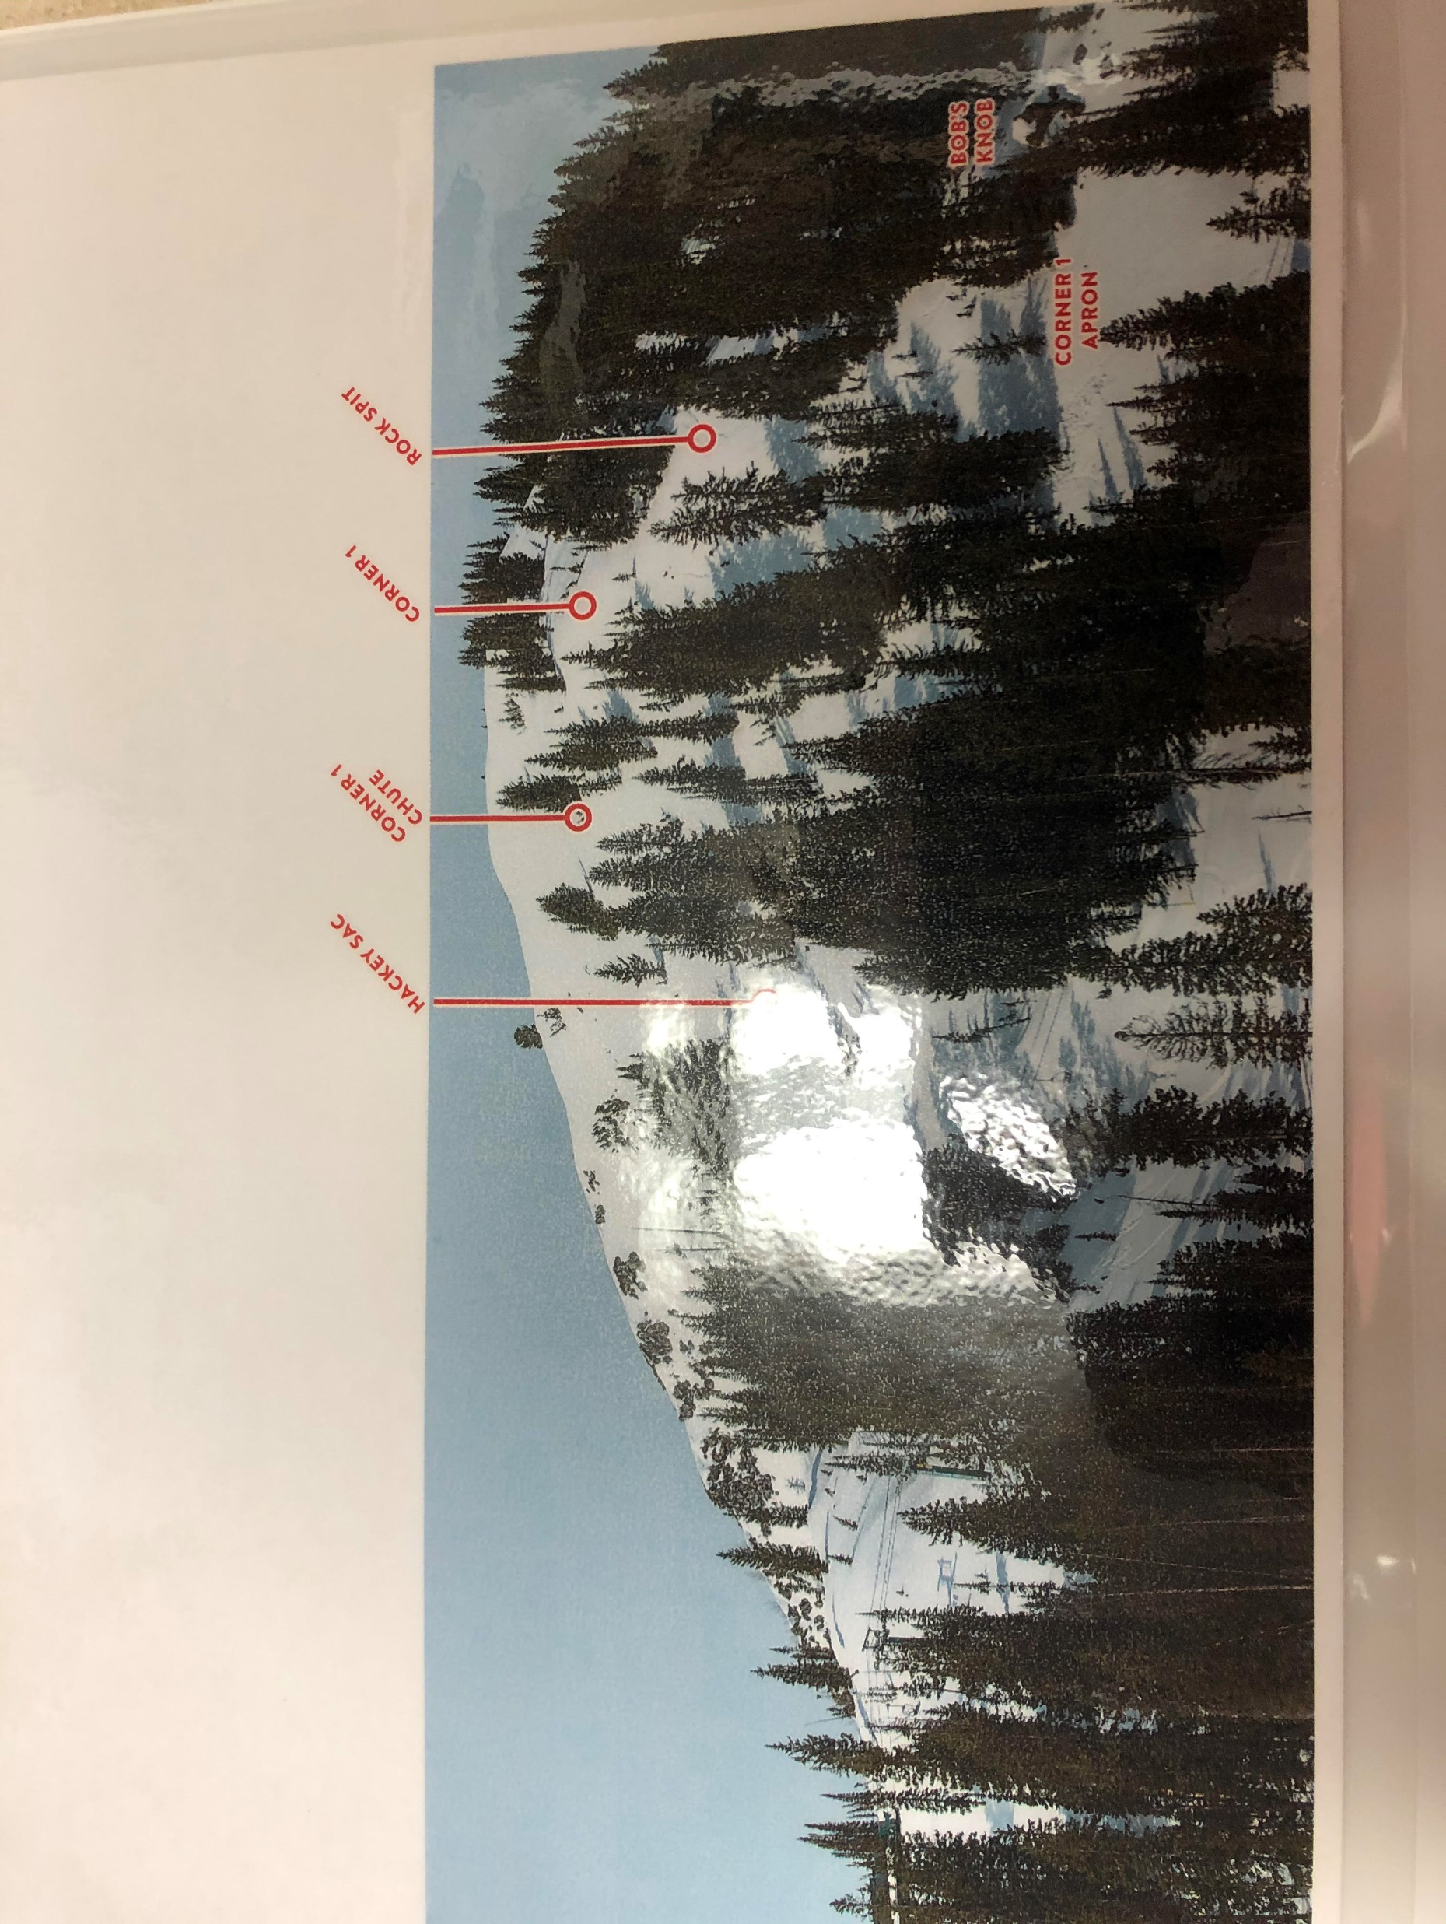
Pioneer Route – Corner 1 Pioneer Corner 1 and 2 plan routes together

Slide 8
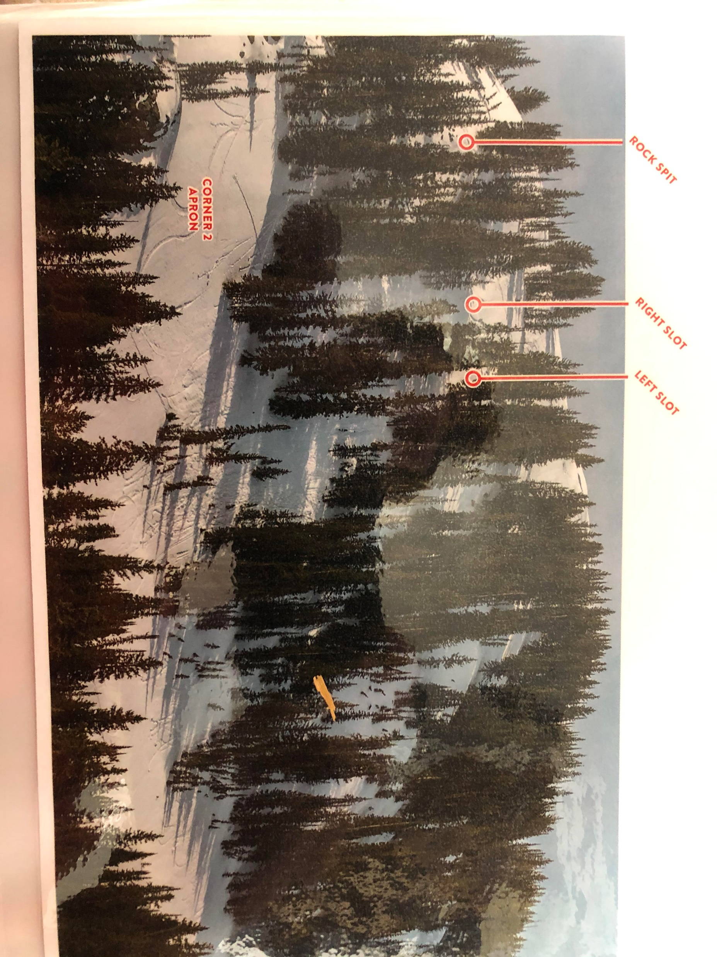
Pioneer Corner 2

Slide 9
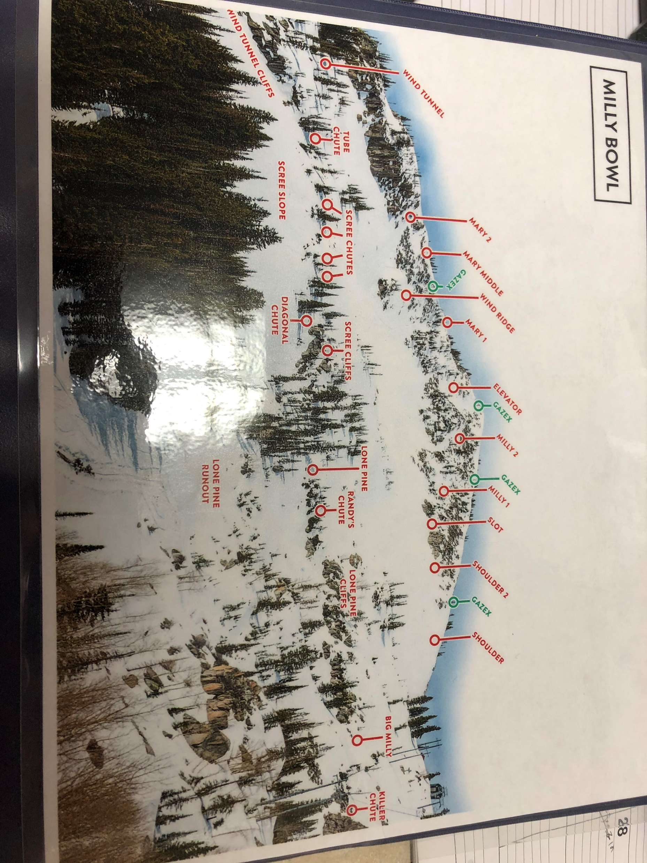
Milly High Fire 4 Gazex 1st as protection to head into the bowl.

Slide 10
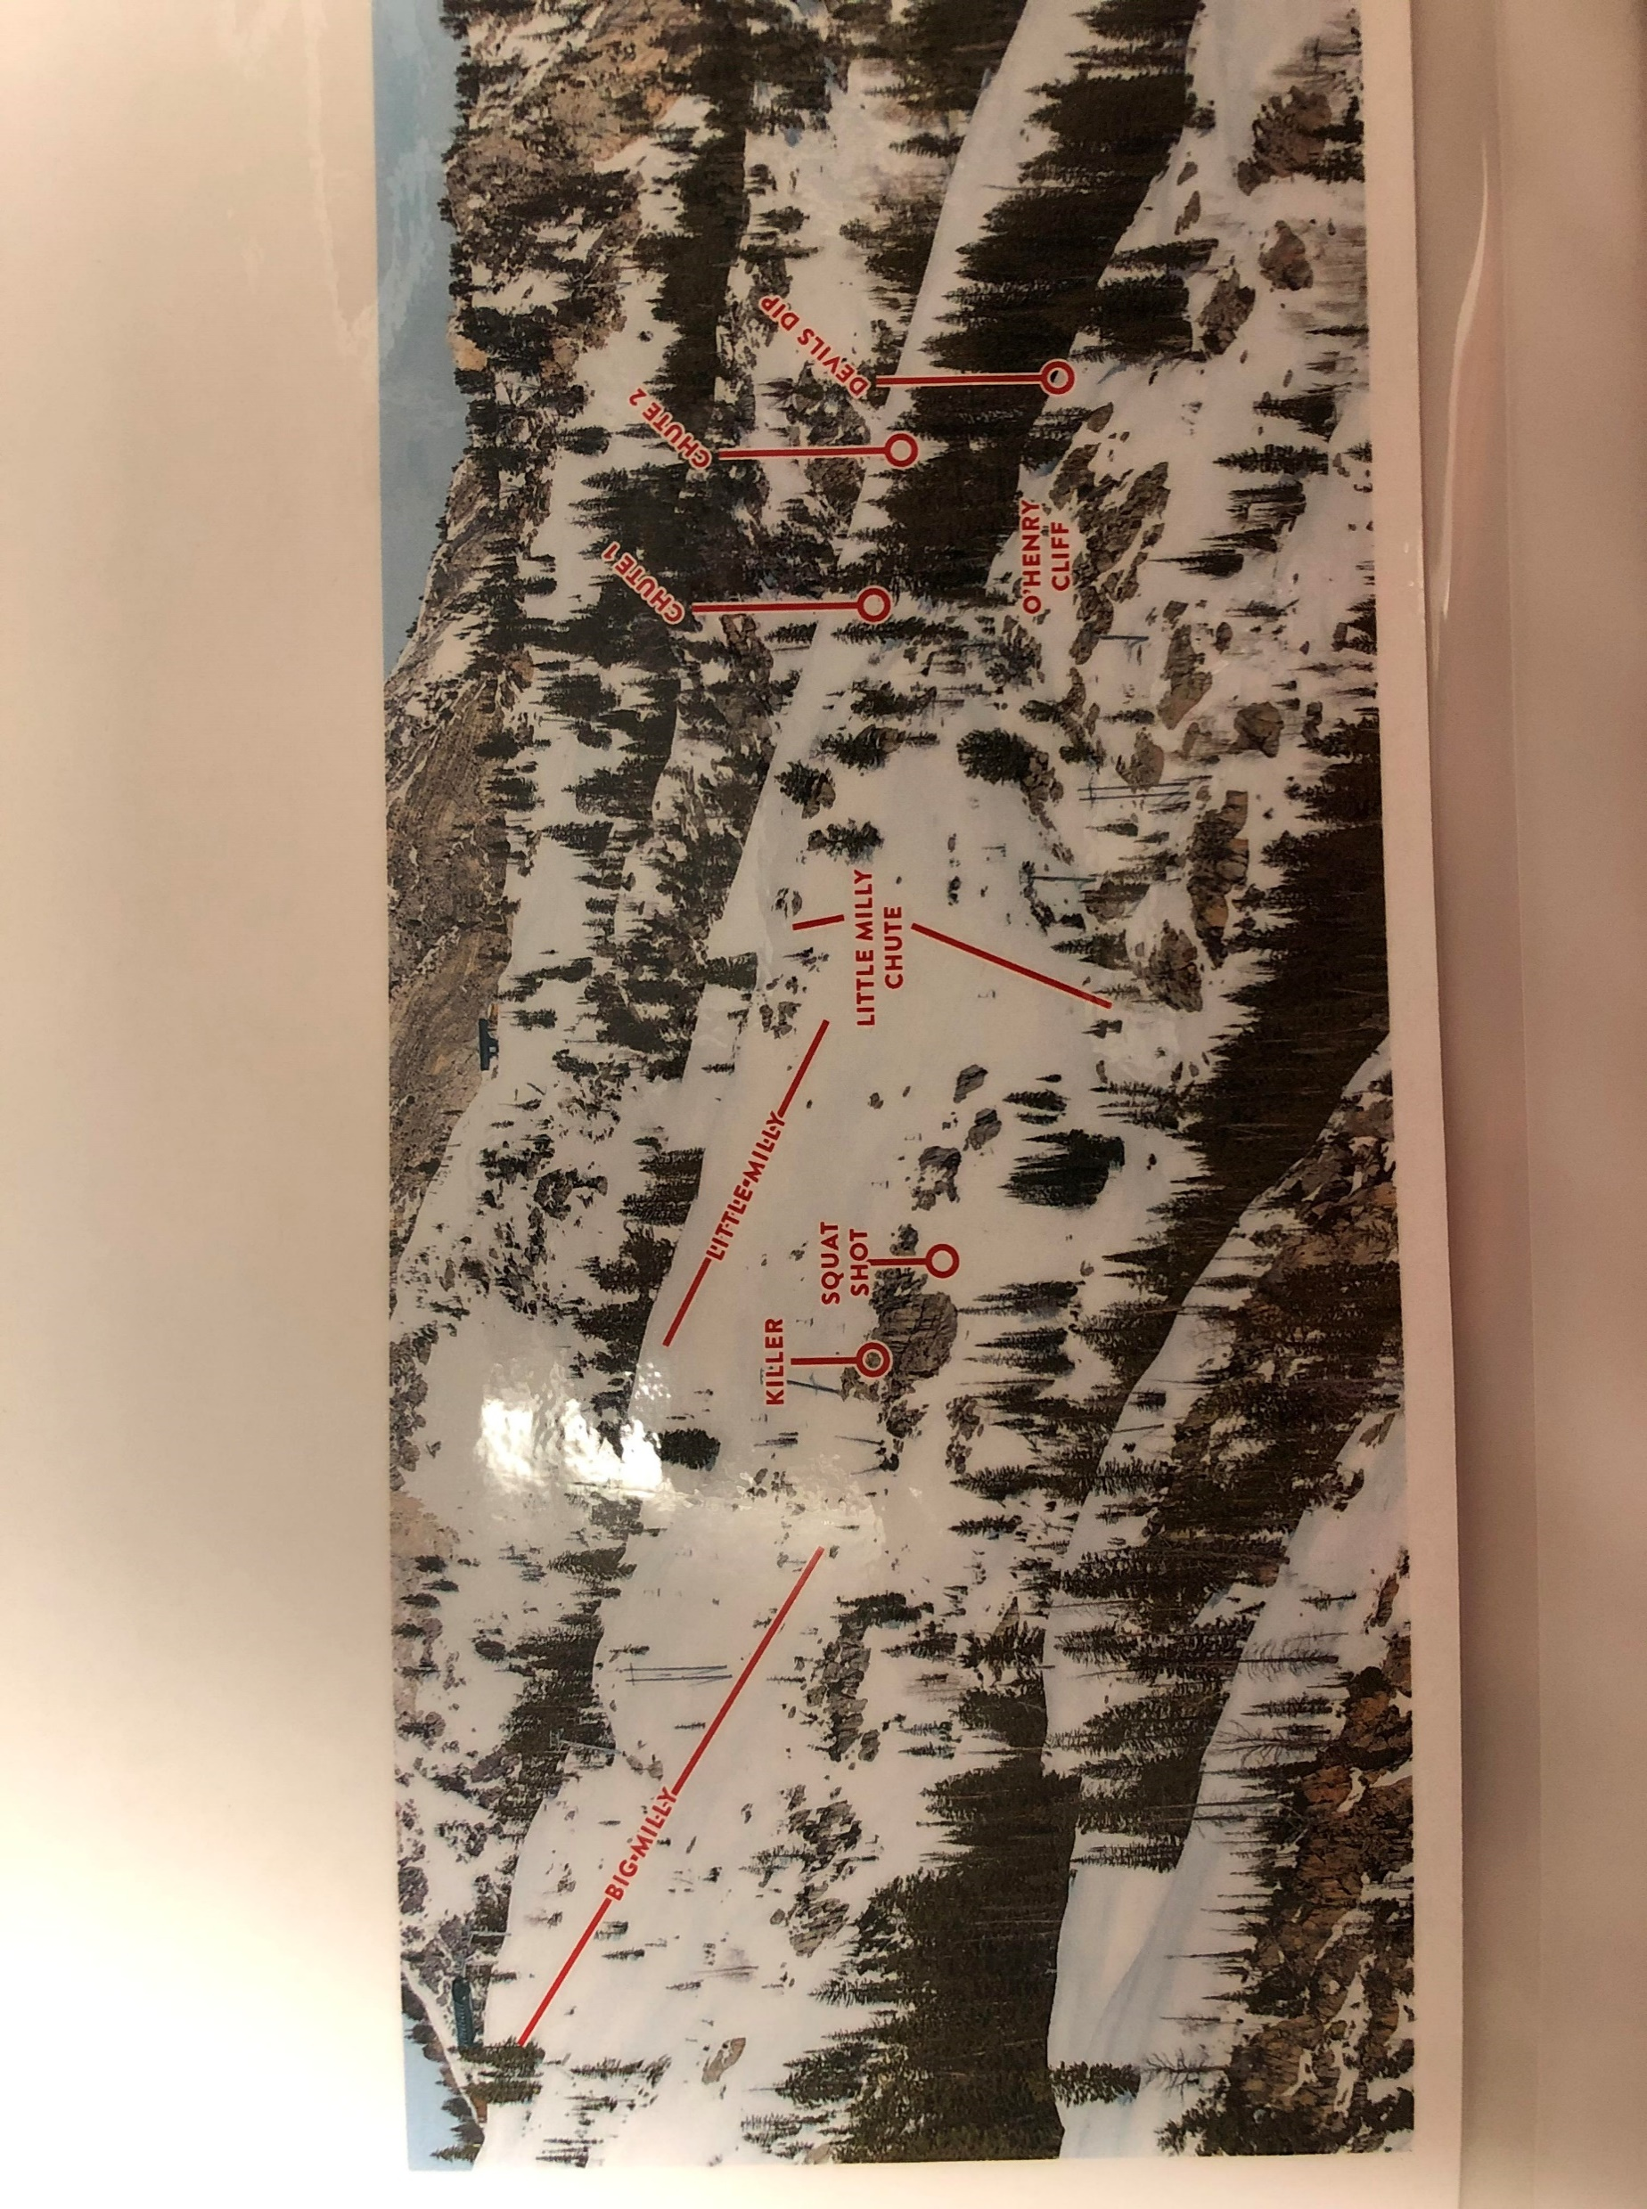
Milly Low – Little Milly Milly High can drop shots onto Killer and Squat from lift Usually a Pioneer team will come over.

Slide 11
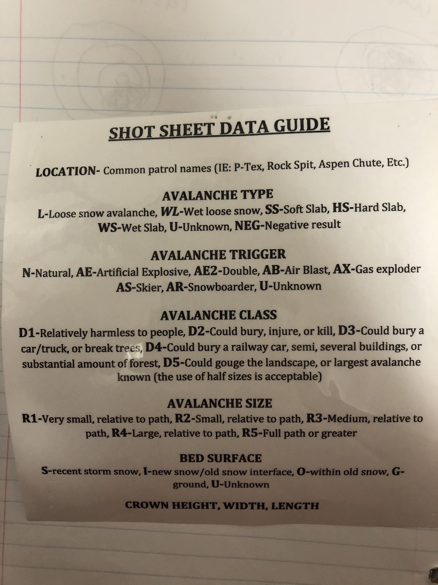
Pro standards for filling out a Shot Sheet

Slide 12
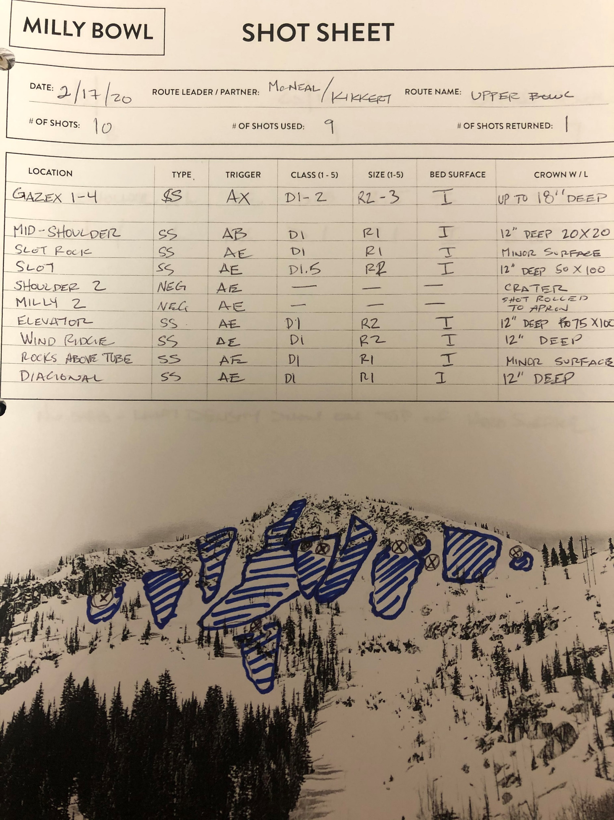
Completed Milly Mitigation Log

Slide 13

Avalanche Mitigation Route Safety

Slide 14
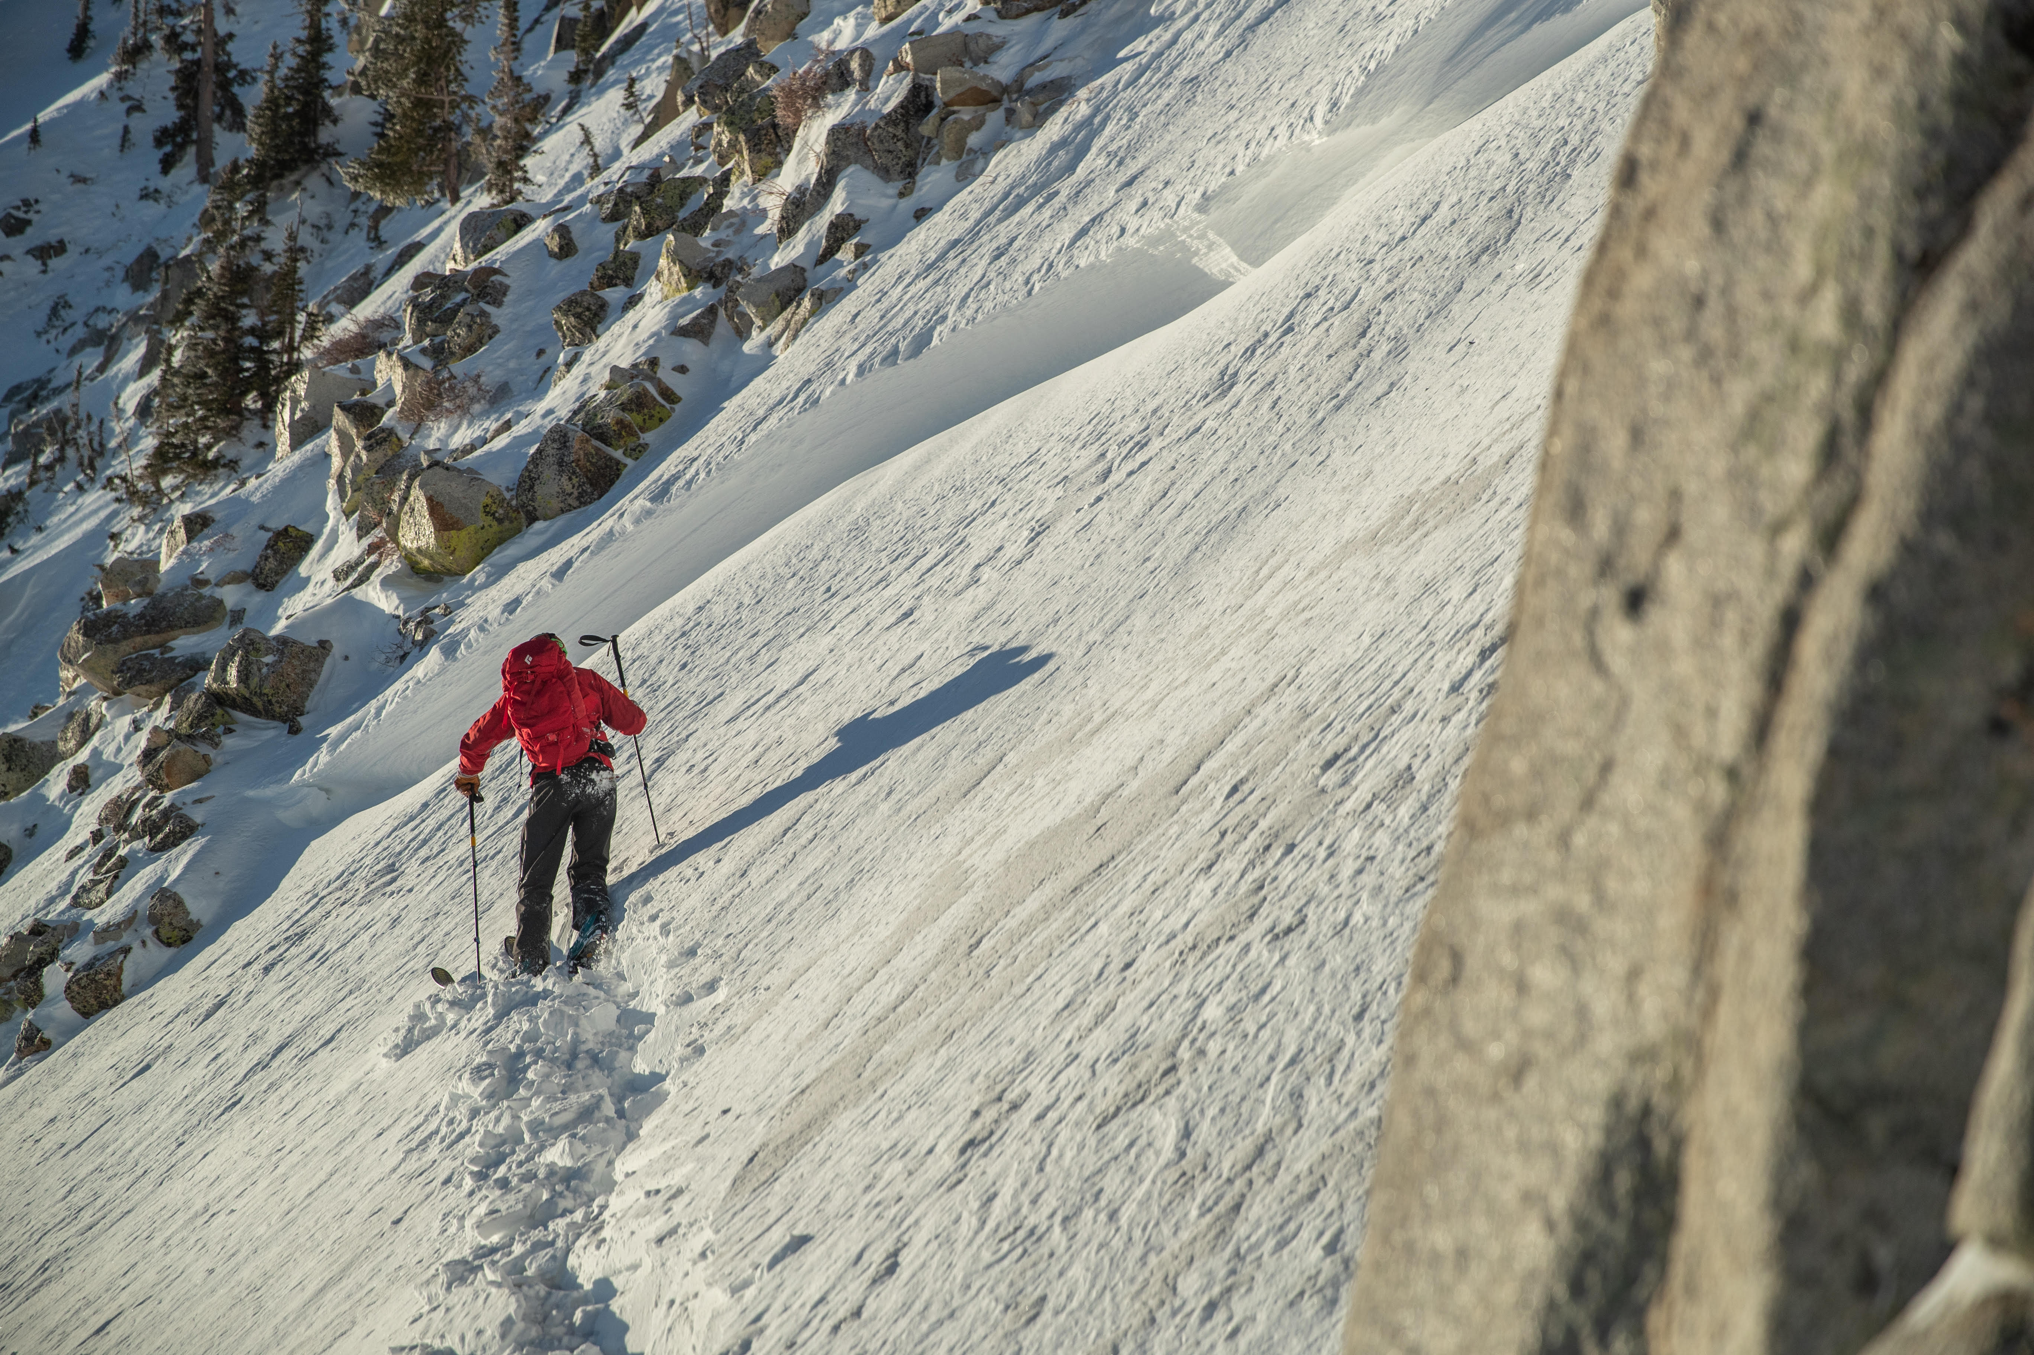
Avalanche Mitigation work is an inherently dangerous aspect of Ski Patrolling; and an incredibly satisfying aspect too. When done safely and properly, we can significantly reduce the risk to ourselves. However, we work in the mountains in a fast-changing environment. With that in mind, there will always still be associated risk. Proper training to set patrollers up for success is our goal. Safety is our number one priority, of our patrollers, resort employees, and guests. While on route, your safety is up to yourself and your partner.
Tuck heading out to try and release some hanging pockets

Slide 15
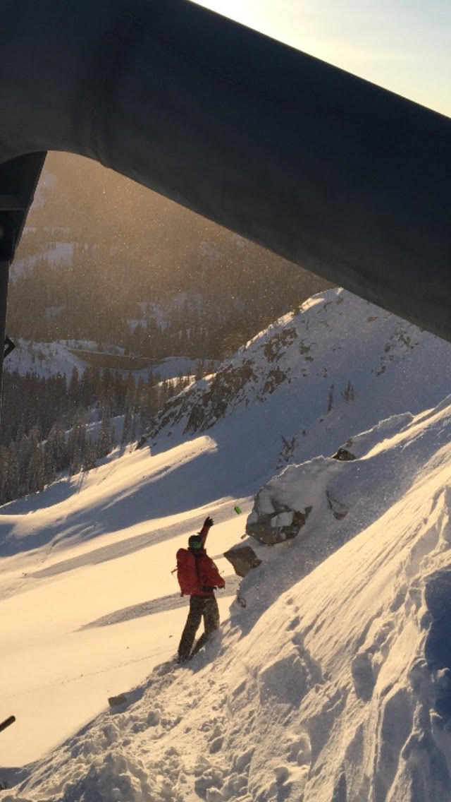
As professional ski patrollers we step into avalanche terrain with the intention of purposefully starting many smaller avalanches, to try and prevent larger, more destructive slides. Which opposes the backcountry mindset of avoiding avalanche terrain when conditions dictate so.
Tuck tossing one in Shoulder 2, Gazex results in the background.

Slide 16
Despite our best efforts, things can go wrong. Therefore, no one goes out on mitigation routes without approval displaying a professional level of partner rescue abilities (criteria presented later). All pro patrollers will practice on-going, season-long weekly trainings. You are your own forecaster/observer/planner on route, pay attention to what the snow and weather are doing…wind drifts/loading, cracking, collapsing, etc.… CLEAR COMMUNICATION with your partner is paramount to success. If something is un-clear, take the time to clarify. Don’t be afraid to be direct. Don’t make assumptions! Know your islands of safety and have voice and/or visual contact with your partner. You and your partner are a team, everyone must feel comfortable voicing concerns, and listening to the concerns of others. It’s ok to step back and re-assess. Have a plan before you step out of the cat/unload the lift. Be willing and able to follow/adjust/abandon a plan as seen fit. Our work environment is so dynamic, we must also be.

Slide 17
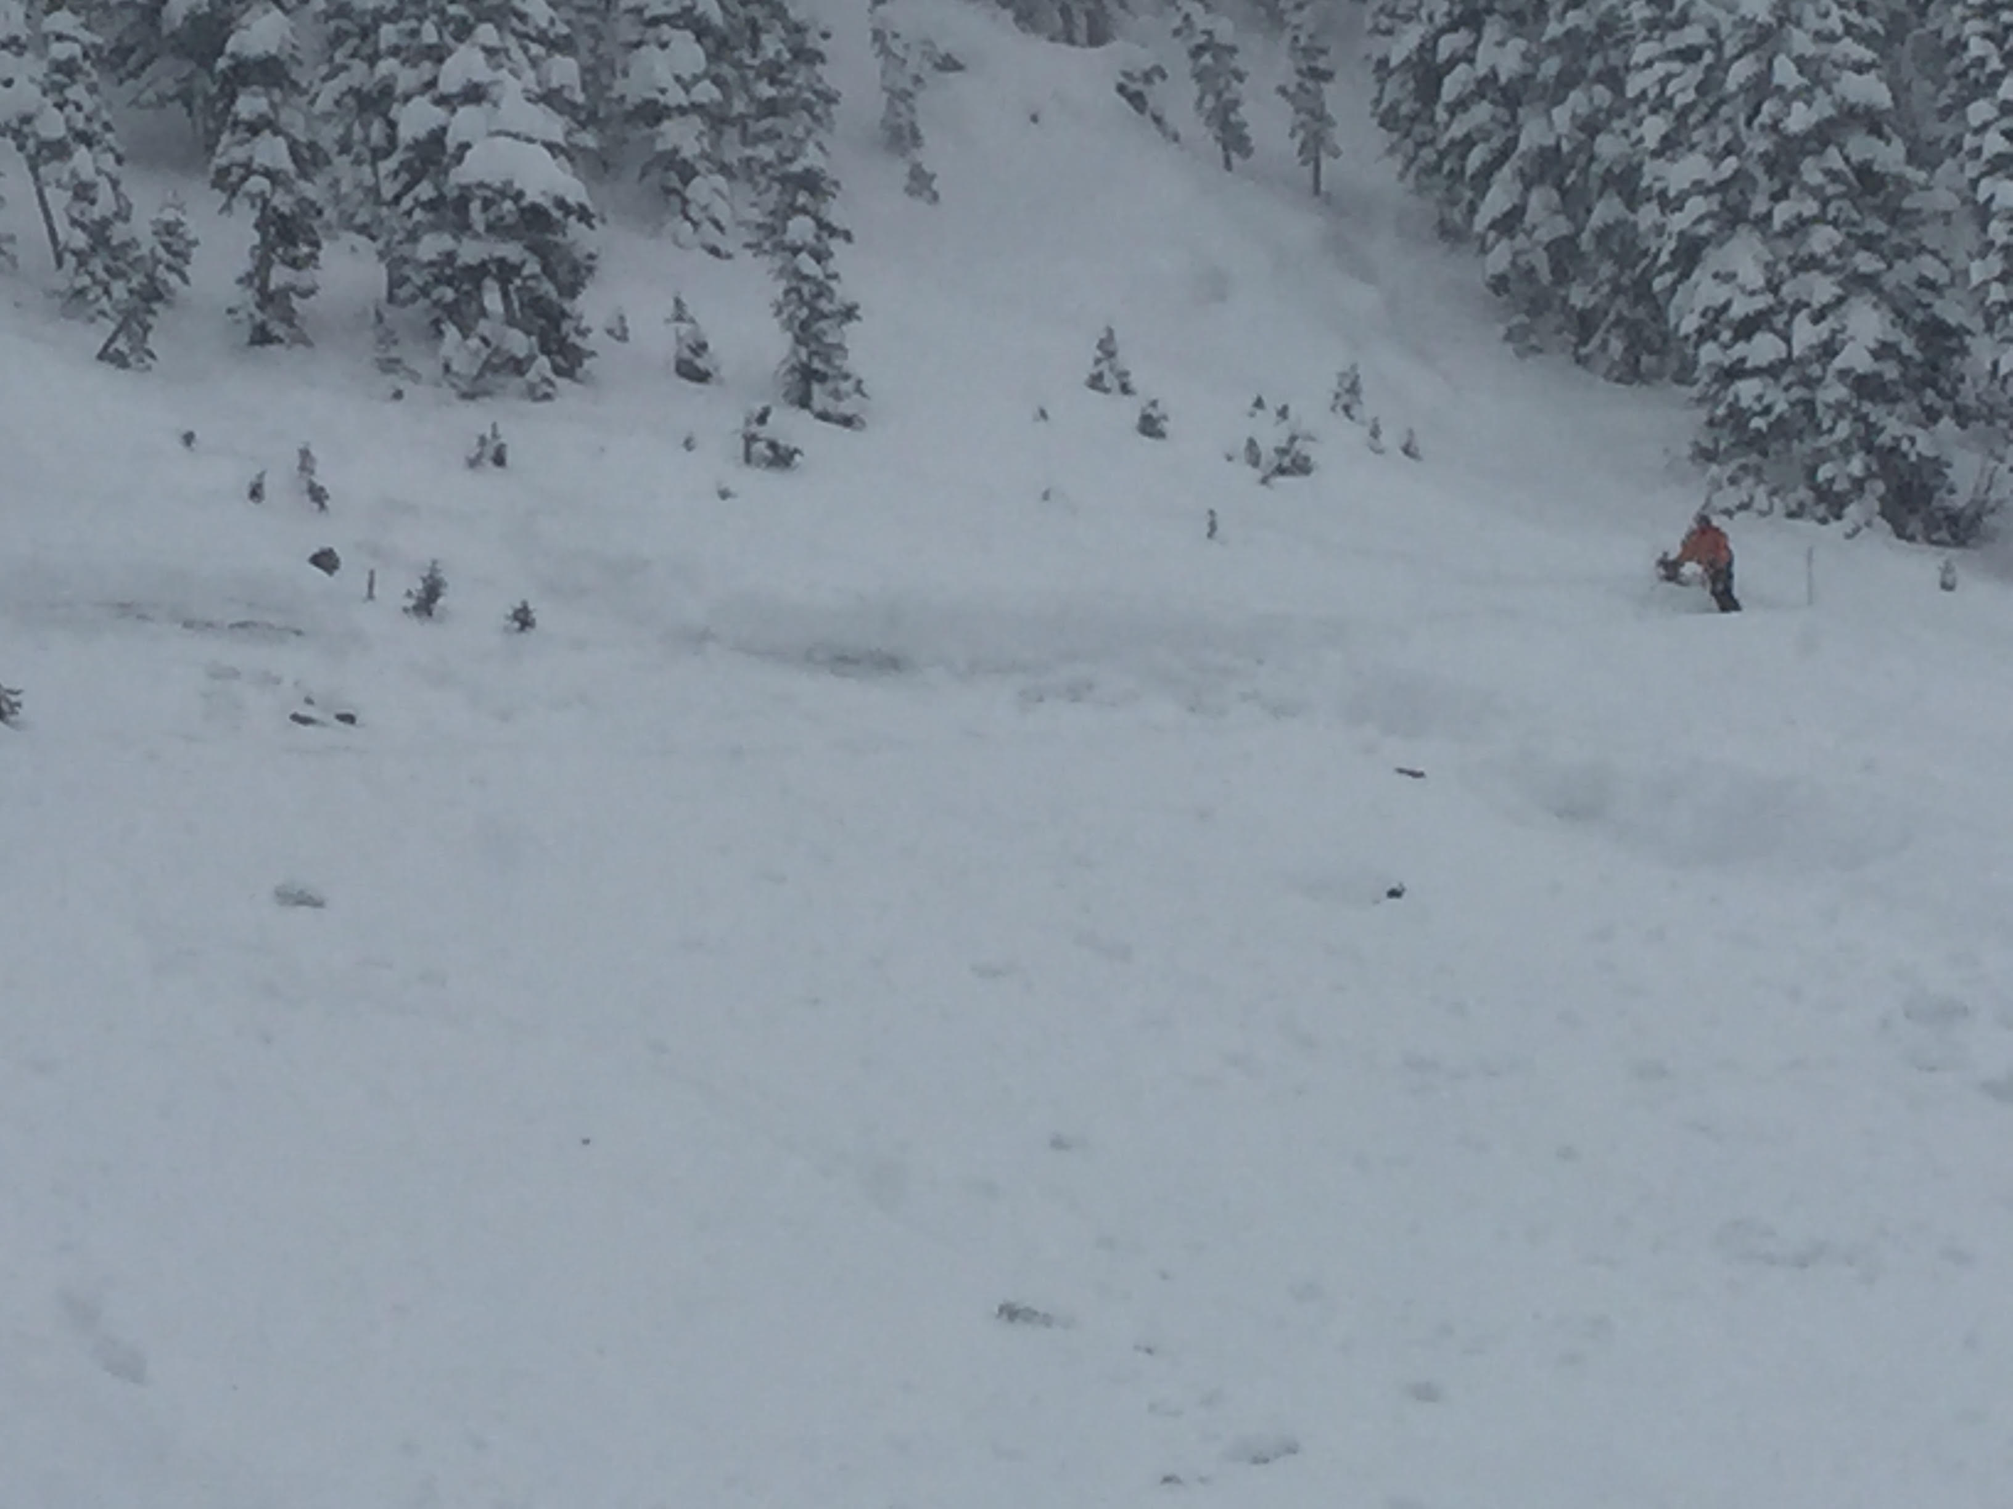
Slow is smooth, smooth is fast. Have a plan, execute it, and move on. No reason to spend excessive time in potentially dangerous terrain. Have your hypothesis – I think the load is greatest here, and most likely to propagate here, so the shot goes there. Was I right? Approach each route with caution and questions, complacency can lead to mistakes…..FACETS!!!! Weird storms can make for weird avalanches…..how much weirder can 2020 get? “Never be afraid to back off from a bad decision.” Don Sharaf If something feels off, analyze it. “Appreciating accomplishments leads to complacency, appreciating mistakes leads to avoiding them.” Unknown We all make mistakes, but in this realm, they can have severe consequences. Don’t allow small mistakes to lead to a big one.
Max checking out Snake Bowl after results stepped down to depth hoar.

Slide 18
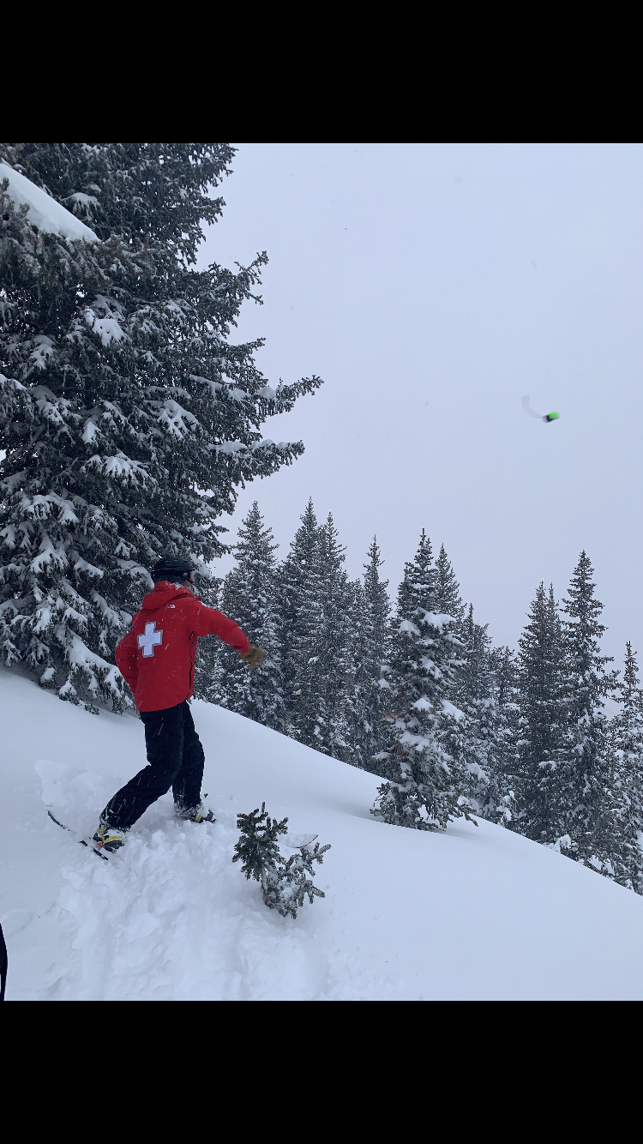
All patrollers will complete an Explosives self test (done annually), covering - Handling/Parts/Procedures. Tucker or Max will go over all of this with rookies; additionally you will receive hands on training for explosive use. Rookies will also get on hill training for explosive placement, and techniques for moving efficiently and effectively through avalanche terrain; before going out on route.
Nate throwing one off Pioneer Ridge

Slide 19
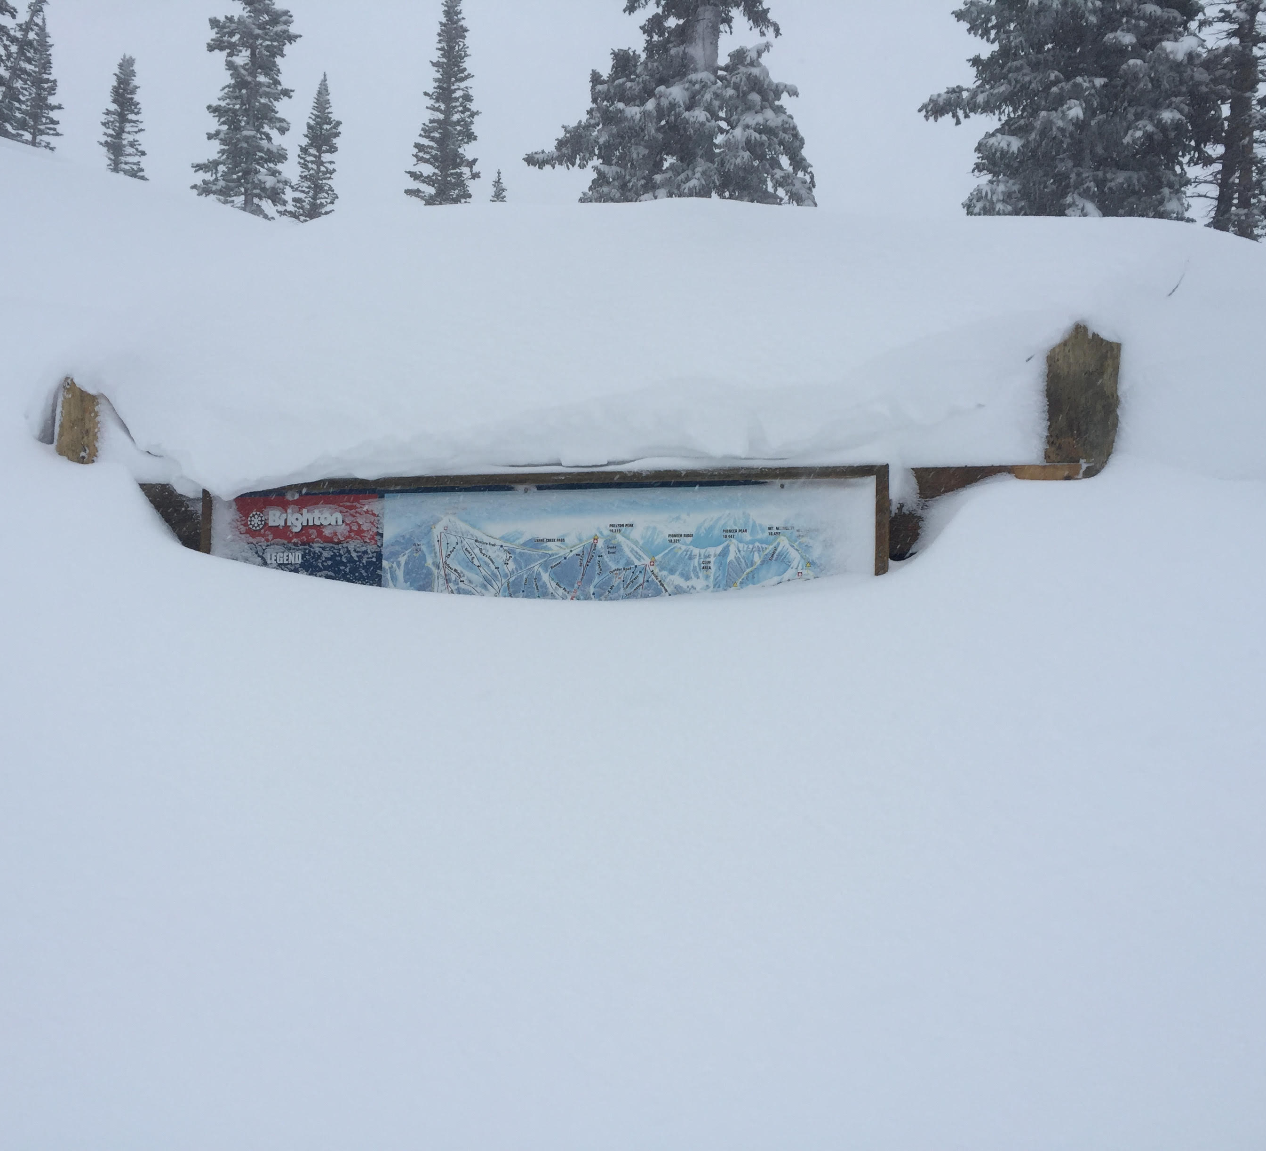
Route Leaders will be established every mitigation morning. It is the responsibility of the Route Leader to clear the zone they are responsible for. If you’re not feeling comfortable with clearing it, let snow safety personnel know. Route Leaders are also responsible for making sure the shot sheet gets done. While we aim to get the entire resort open by 9, our safety, and the safety of our guests is top priority. If we need to delay an opening to make sure it is safe, then that’s what we’ll do.
Trail Map at Crest Top buried during a fat winter.

